Slide 1


Real or Not? NLP with Disaster Tweets
Gryffindor
Notes:
An incident happened in India last year. When a passenger urgently needed a medicine during his train journey . His friends sent a tweet to the Indian Railways and asked for help. Luckily, the railways responded and delivered the medicine on time.​
​
Hi everyone!​
We are Gryffindor and our final project is Real or Not? NLP with Disaster Tweets

Slide 2

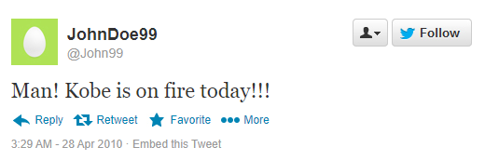
Motivation
The use and impact of social media has skyrocketed over the past decade
A tweet could even serve as first news regarding an accident or a fire.
But tweets are confusing: “Kobe is on fire today!!!”
It is very hard for a machine to realize that this tweet is not about a fire but, about a person's game.
Notes:
The story brings me to the motivation behind this project.
The use and impact of social media platforms (e.g., Twitter, Facebook, LinkedIn) has skyrocketed over the past decade. They have become critical components of emergency preparedness, response, and recovery. Twitter has been widely regarded as active communication channel during emergency events such as disasters caused by natural hazards. A tweet could even serve as first news regarding an accident or a fire. If these tweets are noticed early by response teams, they would get more time react to the situation.
This brings me to the motivation behind this project. As it is not always clear that a person's tweet is announcing a disaster or not.
A tweet reads, "Kobe is on fire today". It is very hard for a machine to realize that this tweet is not about a fire but, about a person's game.
We want to build a simple and effective binary classification model which could classify between Real tweets about disasters and general tweets. This model would be an initial attempt to design a pipeline for contextual based Natural Language Processing which could later be used for Topic Modeling as well.

Slide 3


Our Aim
To build a simple but effective binary classification model to classify disaster and general tweets
The model would be an initial attempt to design a pipeline for contextual based NLP, which could be later used for topic modelling
Notes:
We want to build a simple and effective binary classification model which could classify between Real tweets about disasters and general tweets. This model would be an initial attempt to design a pipeline for contextual based Natural Language Processing which could later be used for Topic Modeling as well.

Slide 4
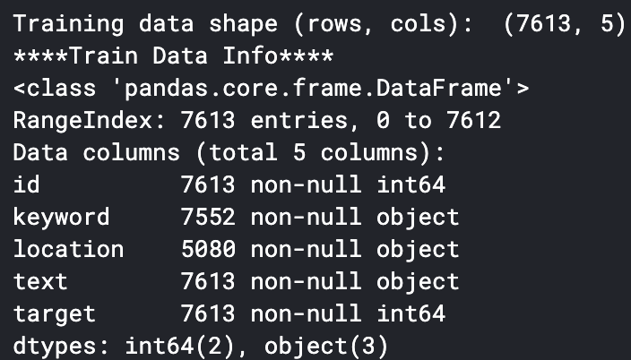
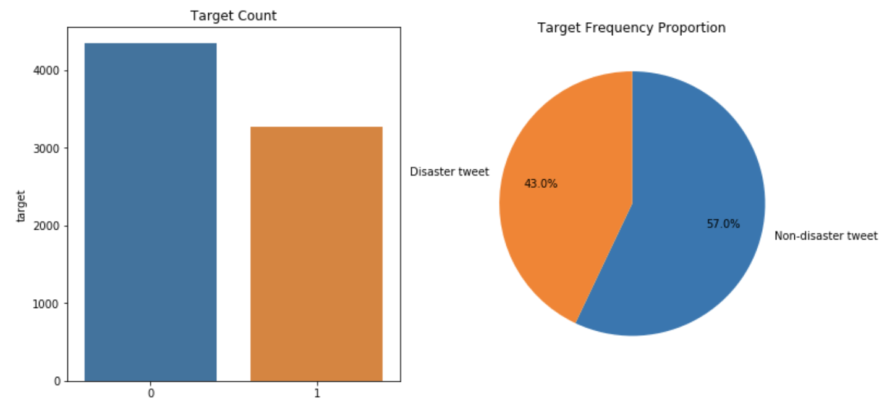
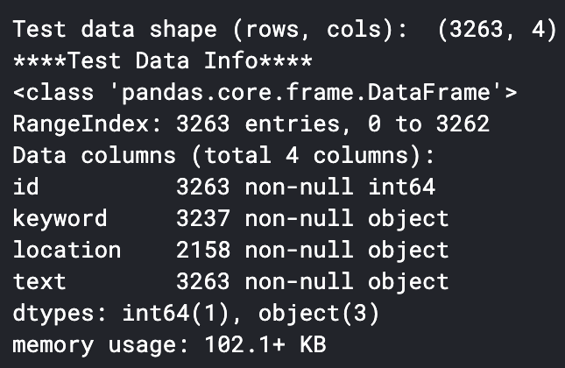
Exploratory Data Analysis
Raw Data
Hash tags
user mentions
urls
Misspelled words
Abbreviations
Average 88 chars per tweet

Slide 5
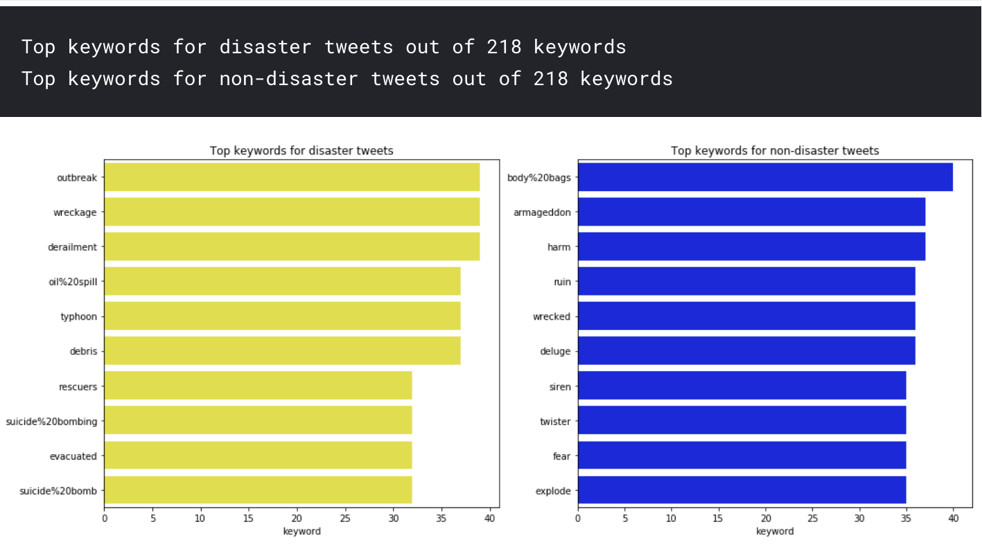
Exploratory Data Analysis

Slide 6
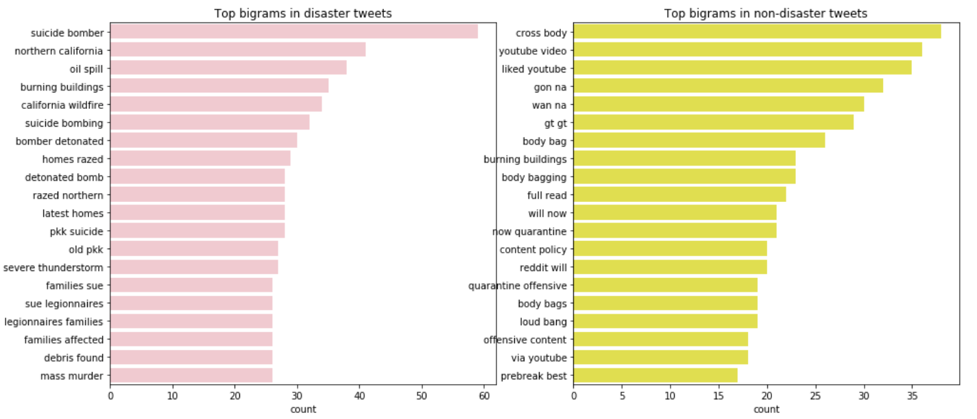
Exploratory Data Analysis

Slide 7
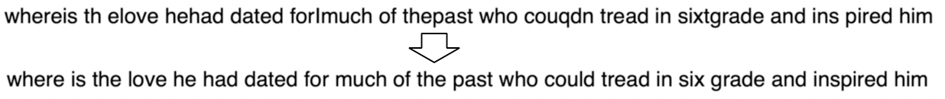
Pre-processing
Usual Text preprocessing
Handle Unicode characters and special characters(such as emojis), Words containing numbers, Lemmatization and Removal of stop words
Advanced Text preprocessing
Contextual spelling correction
Time taken for 10876 tweets: 371 seconds
Abbreviations (NYC -> New York City)
Repetitive characters (coooooool -> cool)
Expand contractions (I’ve -> I have)
Notes:
Thank you Saurabh!
As we are dealing with social media's un-structured text, we had to do more than usual pre-processing steps.
So we implemented a bunch of methods.. and according to the need of different models, relevant methods were picked.
Except the usual preprocessing like stop word removal and emoji’s removal etc.
We implemented methods for like contextual spelling correction whose example we can see on screen ..and can predict its impact.
Seeing our dataset we were inspired to implement methods for abbreviation expansion, removing repetitive character (as …people like to express their excitement on social media you know;) ) and expand contractions.
One of the interesting and effective method is

Slide 8
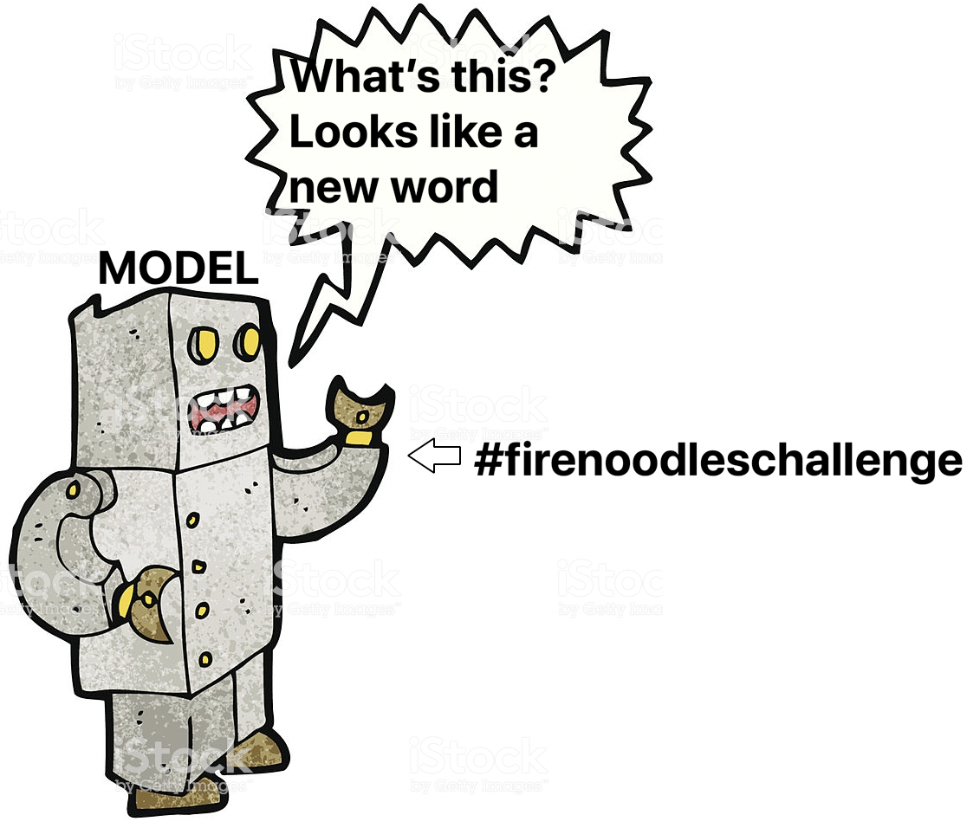
Pre-processing (Cont.)
Word segmentation of hashtags
Notes:
Hashtag to words
If you training a model or using pretrained model or embedding, all its learning fails ..when we input a hashtag because it is kind of a new word for the model and hence its previous learning …towards the semantic of ..words of hashtag … is not used.
So we simply broke the hashtag ..to words for our model

Slide 9
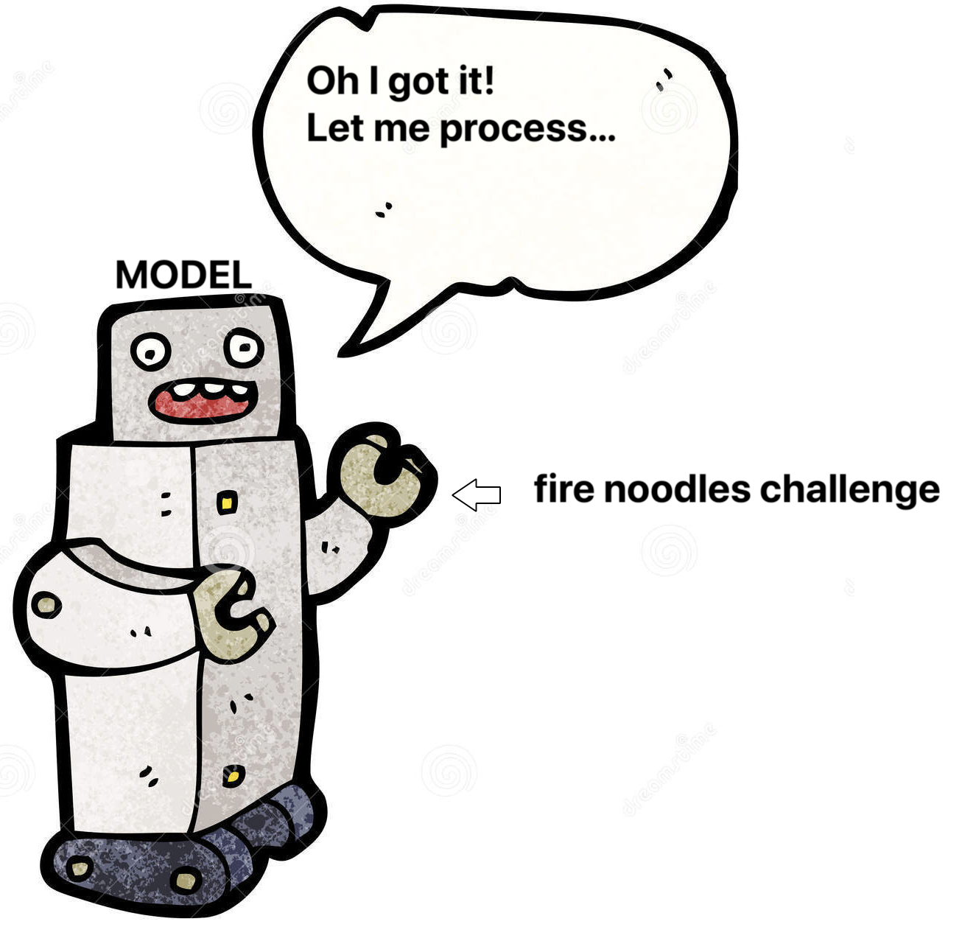
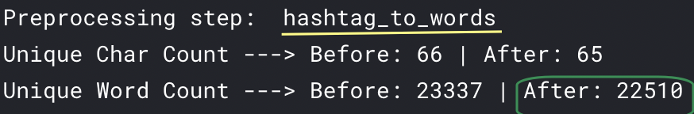
Pre-processing (Cont.)
Word segmentation of hashtags
Notes:
and it looks pretty happy
Going by number, not just words, we can see that number of unique word count before and after this preprocessing step dropped by around 1000 words.

Slide 10
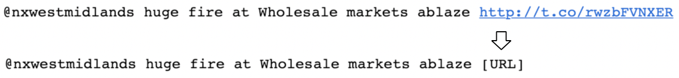
Pre-processing (Cont.)
Word segmentation of hashtags
URLs
Notes:
Next, As we saw before.. that URL holds some decision impact.. we replaced URL links with URL as a word.. Which will remove the noise and will still retain information.

Slide 11
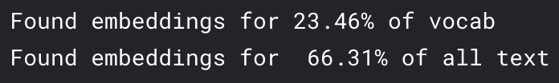
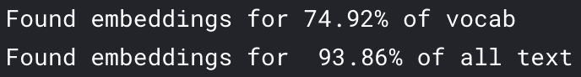
Pre-processing (Cont.)
Analyzed using BERT embedding
Before pre-processing
After pre-processing
Notes:
To analysis the effect of our preprocessing, we compared our data vocab with BERT vocab.
We want that most of our vocabulary words should be found in BERT vocabulary or we can say embeddings.
And preprocessing actually gave us impressive result. We can see that before preprocessing we found embedding for just 66 percent of the text.. Whereas after pre-processing embedding was found for the 94% of the text .

Slide 12
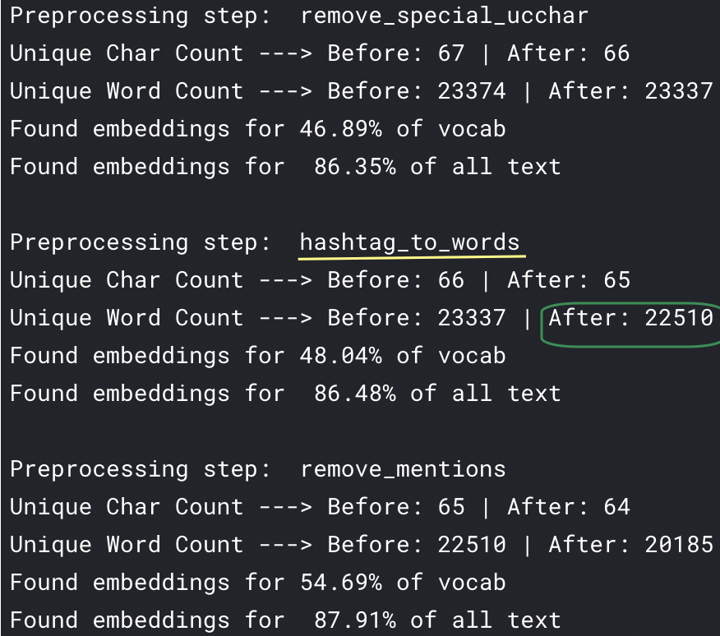
Pre-processing (Cont.)
Analyzed using BERT embedding
Before pre-processing
After pre-processing
Notes:
Some of the magical methods are .. hashtag_to_words

Slide 13
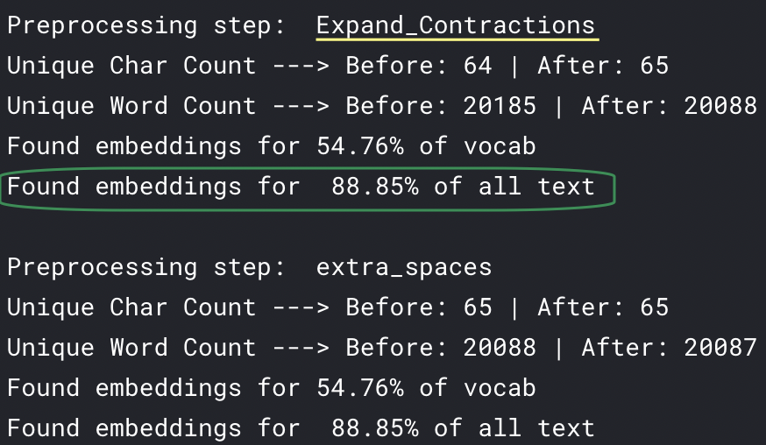
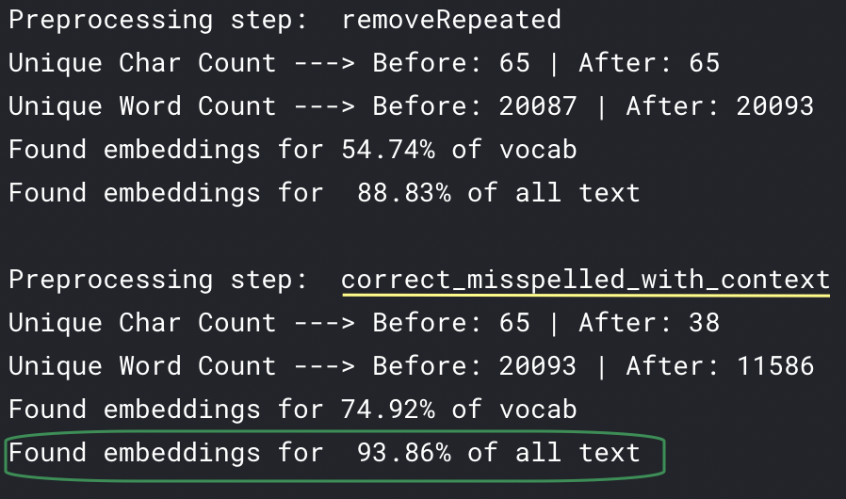
Pre-processing (Cont.)
Analyzed using BERT embedding
Before pre-processing
After pre-processing
Notes:
expand_contraction and correcting misspelled where embedding found metric jumped by FIVE%

Slide 14
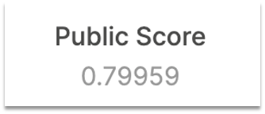

SVM
maximize the margin around the separating hyperplane.
RBF kernel
GridSearchCV for tuning hyper parameters and got best value of c=1.5, gamma=0.6
Gamma is the kernel coefficient for ‘rbf’.
XGBOOST
A powerful decision-tree based Ensemble model that employs Gradient Descent.
feature size depends on the vocabulary of the data.
hyper-paramaters like regularization, learning rate
over-fitting -> optimize hyper-parameters like max-depth of tree
Notes:
Thank you sonam,
The first model that we tested is svm with rbf kernel. SVM is a discriminative classifier formally defined by a separating hyperplane.
The input to svm is the processed text which is converted to matrix of tf-idf features
We used gridsearchcv for tuning parameters
F1 score achieved by svm is 0.79
This model gave satisfactory results, but while considering informal language sources such as tweets, the data is always with high levels of noise.
Since the tweets are manually labelled, we can expect some noise even in labelling of the data.
So, a simple decision tree based model, that is equipped with Bagging and Random Forrest(to handle high dimensions), Boosting(to put some context into the words from each tweet) and gradient decent to arrive at minimal loss, sounds promising.
So we implemented XGBoost A powerful decision-tree based Ensemble model that employs Gradient Descent which has a history of performing extremely well in binary classification tasks.
Since the model is aided by Gradient Descent, regularization, learning rate and many other such hyper-paramaters come into play.
There is not much precedence using XGBoost for Text classification, so we wanted to try it. This model gave us the accuracy of approximately 80.1 percent.
Different accents and lingos used by people, makes it hard for Vectorization to work well in these cases.
We also implemented LSTM model, before moving on to BERT.
Extra :
C is a regularization parameter that controls the trade-off between the achieving a low training error and a low testing error that is the ability to generalize your classifier to unseen data.
XGB = Extreme Gradient Boosting
Decision trees – Bagging(Making multiple Decision trees) – Random Forest(Making multiple trees with only a subset of features) – Boosting(Sequential trees, with feedback from previous layers) – Gradient Boosting(Gradient descent is used to minimize error in boosting) = XGBOOST
Uses parallel processing for computations
Hence, an ensemble model aided by gradient descent might be out best bet.
After playing with the hyper paramaters and different input types – TFIDF & Count Vectorizer, we went forward with Count Vectorizer and finally ended up with the accuracy from the screenshot.
Links:
https://towardsdatascience.com/https-medium-com-vishalmorde-xgboost-algorithm-long-she-may-rein-edd9f99be63d
https://machinelearningmastery.com/gentle-introduction-xgboost-applied-machine-learning/
https://xgboost.readthedocs.io/en/latest/tutorials/param_tuning.html

Slide 15

LSTM
A special type of RNN, capable of learning long-term dependencies
Bi-LSTMs focus on the past and the future directions of the input
Embedding layer
two layers of Bidirectional LSTMs with max pooling and average pooling
Batch size, epochs, Activation functions are some of the hyperparameter used
0.80265
Notes:
Long Short-Term Memory Networks are a particular type of recurrent neural networks capable of learning long term dependencies. It can learn to keep only relevant information to make predictions, and forget non relevant data.
we have used Bidirectional LSTMs which are an extension to typical LSTMs that can enhance performance of the model as it trains two LSTMs instead of one on the input sequence. The first is as-is and the other on a reversed copy of the input sequence. By this, additional context is added to network and results are much faster.
The processed text is vectorized by a tokenizer which transforms input text to sequence of integers (each integer being the index of a token in a dictionary) which is taken as the input to the model
* Bidirectional LSTM has a embedding layer, instead of loading random weight we have loaded the weights from our glove and crawl embeddings. This layer encodes the input sequence into a sequence of dense vectors
on top that We have used two layers of Bidirectional LSTMs where Bidirectional layer takes a recurrent layer (LSTM) as an argument and have also used one directional max and average pooling To reduce dimensionalty
* the accuracy of this model is 80.2%
Embedding layer -> dropout -> 2 bidirectional lstms -> concatenation (1d global max pooling and 1d global average pooling ) + dense layes with relu and sigmoid activation functions
The processed text is vectorized by a tokenizer which transforms input text to sequence of integers (each integer being the index of a token in a dictionary) which is input to the model
LSTM input is 3-d array (batch size, timesteps - number of time-steps you are feeding a sequence, seq_len - number of units in one input sequence)

Slide 16
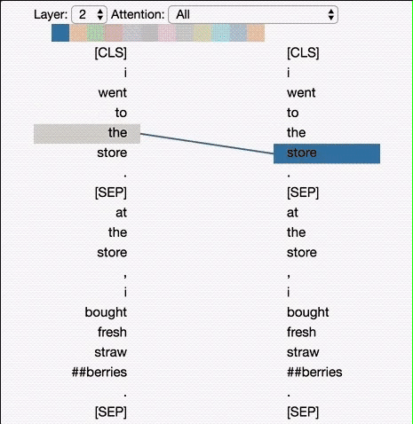
BERT For NLP
BERT (Bidirectional Encoder Representations from Transformers) — a major breakthrough which took the Deep Learning community by storm because of its incredible performance.
The image on the right visualizes attention as lines connecting the position being updated (left) with the position being attended to (right). Colors identify the corresponding attention head(s), while line thickness reflects the attention score.
Source
Notes:
Thanks Sameera !
We are using Pre trained BERT as our final model.
We will start with some of the specifications of the BERT and how its trained and then we will move on with how we fine tuned it to use it for our classifcation purpose.
BERT is a major break through in the field of NLP which took the community by storm because of its incredible performances.
Before BERT Processing starts it adds
A [CLS] token to the input word tokens at the beginning of the first sentence and a [SEP] token is inserted at the end of each sentence. This is also known as token embedding.
Here we also Maintain Segement Embeddings and Positional Embeddings .
The image on the right helps us visualize the attention as lines connecting the position being updated (left) with the position being attended to (right). Colors identify the corresponding attention head(s), while line thickness reflects the attention score.
We can use this tool implemented by tensorflow to play around.
At the top of the tool, the user can select the model layer, as well as one or more attention heads (by clicking on the color patches at the top, representing the 12 heads).

Slide 17
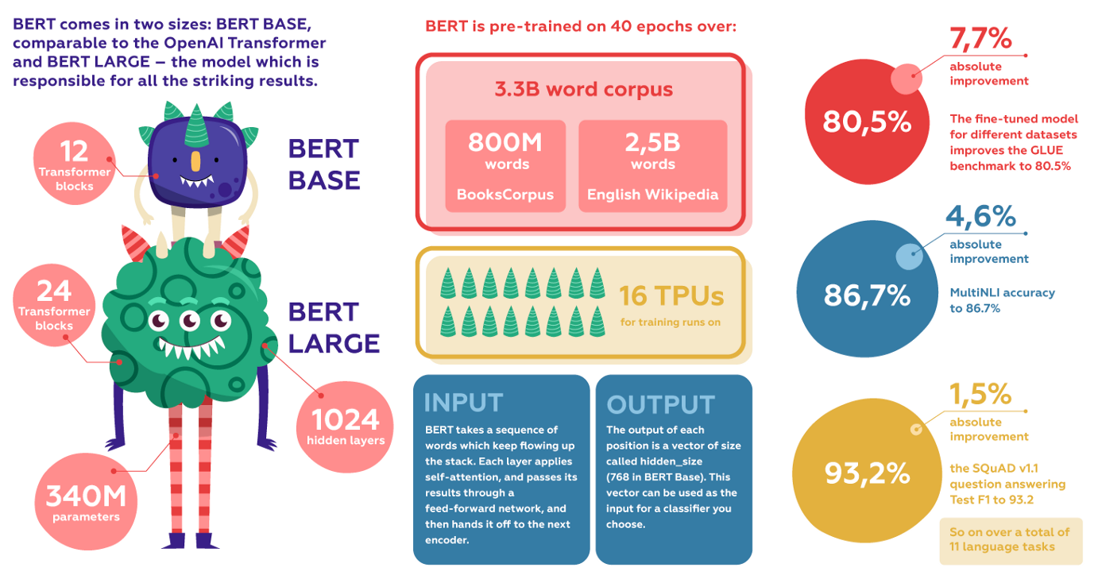
BERT Model at Glance
Source
Notes:
Here are some of the specification about the BERT
There are 2 types of pre-trained versions of BERT depending on the scale of the model architecture:
BERT-Base: 12-layer, 768-hidden-nodes, 12-attention-heads, 110M parameters BERT-Large: 24-layer, 1024-hidden-nodes, 16-attention-heads, 340M parameters.
BERT is pre-trained on 40 epochs over a 3.3 billion word corpus, including BooksCorpus (800 million words) and English Wikipedia (2.5 billion words).
As input, BERT takes a sequence of words which keep flowing up the stack. Each layer applies self-attention, and passes its results through a feed-forward network, and then hands it off to the next encoder.
The output of each position is a vector of size called hidden_size (768 in BERT Base). This vector can be used as the input for a classifier you choose.
The fine-tuned model for different datasets improves the GLUE benchmark to 80.5 percent (7.7 percent absolute improvement), MultiNLI accuracy to 86.7 percent (4.6 percent absolute improvement), the SQuAD v1.1 question answering Test F1 to 93.2 (1.5 absolute improvement), and so on over a total of 11 language tasks.
In the right we can see absolute improvements when compared to other SOTA models.

Slide 18
Advance Techniques used to train BERT
1. Masked LM (MLM)
Randomly mask out 15% of the words in the input — replacing them with a [MASK] token
2. Next Sentence Prediction (NSP)
In order to understand relationship between two sentences, BERT training process also uses next sentence prediction.
3. BERT Tokenization Technique
BERT utilizes WordPiece for tokenization which in effect, splits token like “playing” to “play” and “##ing”. This is mainly to cover a wider spectrum of Out-Of-Vocabulary (OOV) words.
Notes:
Some of the Advanced techniques to train bert
The idea here is “simple”: Randomly mask out 15% of the words in the input — replacing them with a [MASK] token — run the entire sequence through the BERT attention based encoder and then predict only the masked words,
80% of the tokens are actually replaced with the token [MASK].
10% of the time tokens are replaced with a random token.
10% of the time tokens are left unchanged.
During training the model gets as input pairs of sentences and it learns to predict if the second sentence is the next sentence in the original text as well.
As we have seen earlier, BERT separates sentences with a special [SEP] token. During training the model is fed with two input sentences at a time BERT is then required to predict whether the second sentence is sequence or not, with the assumption that the random sentence will be disconnected from the first sentence
Both these techniques are used simultaneously while training.
BERT uses word piece technique to include OOV words.
Now Sushant will explain how are we using and fine tuning BERT to our advantage.

Slide 19
Model Training and Fine Tuning
Pre-trained BERT:
BERT Large
24 Layer, 1024 Hidden, 16 Attention heads
English only
30,000 vocabulary
340 Million parameters
Challenges:
Complex model architecture
Limited to small batch size
Input Layer
BERT layer
Improved Model Optimizer: Adam
Input Layer
BERT Layer
Dense(1024)
Dense(1024)
Dense(1024)
Sigmoid Activation
Sigmoid Activation
Vanilla BERT Optimizer: Adam
Training strategy - 1:
Train model for 1-2 epochs with a LR decay of factor 10
Train half epoch &
decrease LR
Shuffle the data and repeat the process for 2-3 epochs
Notes:
The last 3 layers of BERT are fully connected layers, they do a fine job of classification by themselves.
BERT comes with an assortment of pre-trained models.
Small batch size means, more number of weight updations (back prop) in each epoch with the same learning rate.

Slide 20
Model Training and Fine Tuning
Training Strategy - 2:
Train model for 2-3 epochs
Freeze BERT layer
Train the model
(only Neural Classifier)
Fine-tuning and external models:
Train BERT for 2-3 epochs
Generate embeddings from the trained model
Use Embeddings with SVM classifier and XGBoost classifier
Hyper parameter tuning - Divided between the team with continuous feedback to each other.
Notes:
The way big data tools pass along feedback to each other while processing distributed data, our team even though spread out across the globe(one of our team members is currently working from India) constantly communicated over whatsapp, calling each other at 4'o clock in the morning just to tell that 1e-7 for LR didn't work

Slide 21
Results
Model Specifications | Test Accuracy | Test F1 Score (100% data) | Kaggle public Score (30% data)
SVM | 0.7974 | 0.7271 | 0.7995
XGBoost | 0.7787 | 0.7303 | 0.8016
LSTM | 0.8139 | 0.7666 | 0.8026
Vanilla BERT | 0.8461 | 0.8086 | 0.8548
BERT + Training Strategy 1 | 0.8464 | 0.8082 | 0.8527
BERT + Training Strategy 2 | 0.8467 | 0.8090 | 0.8517
BERT + Training Strategy 2 + SVM | 0.8427 | 0.8079 | 0.8456
BERT + Training Strategy 2 + XGBoost | 0.8369 | 0.7995 | 0.8435

Slide 22
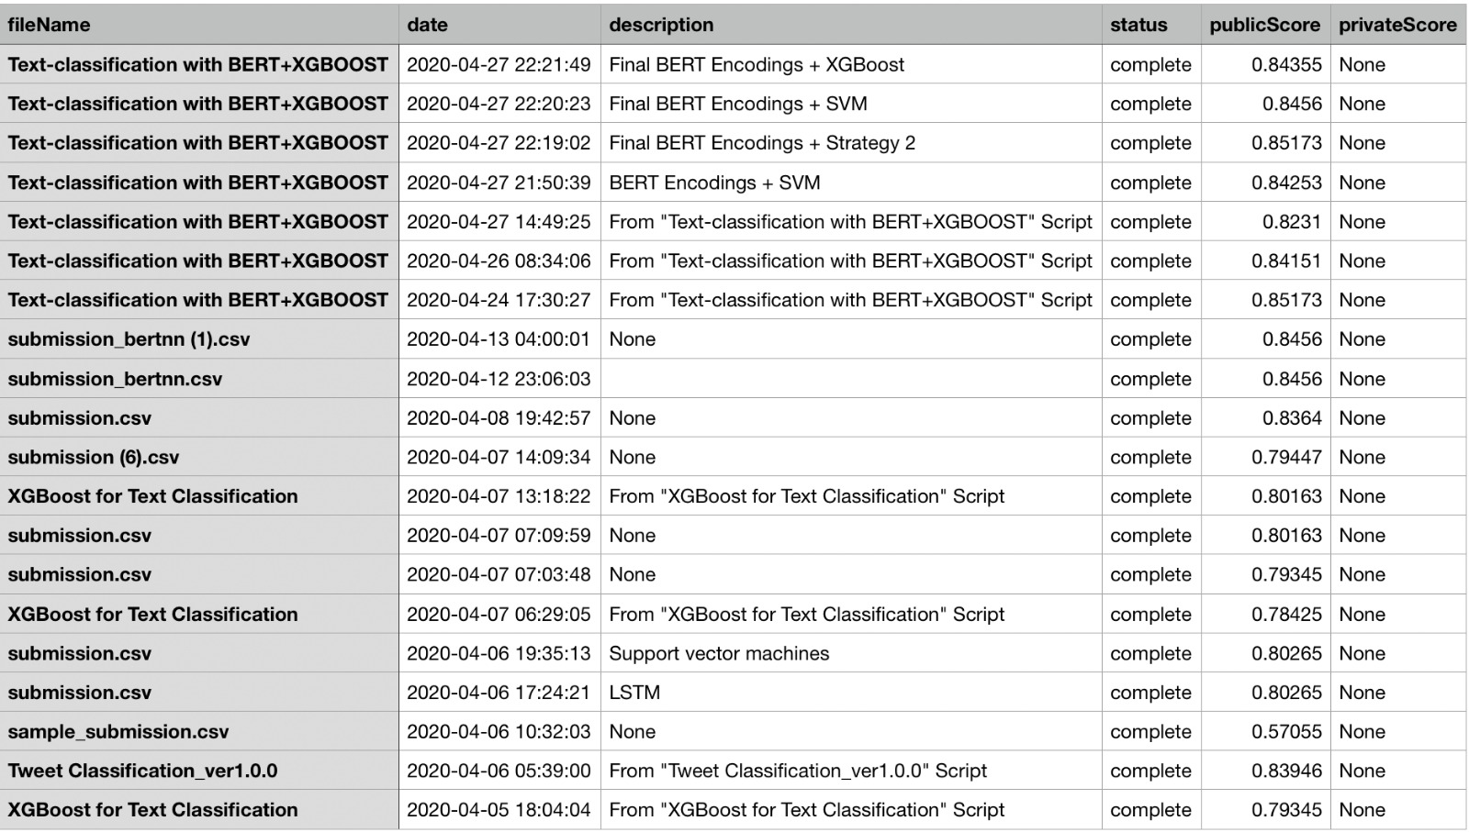
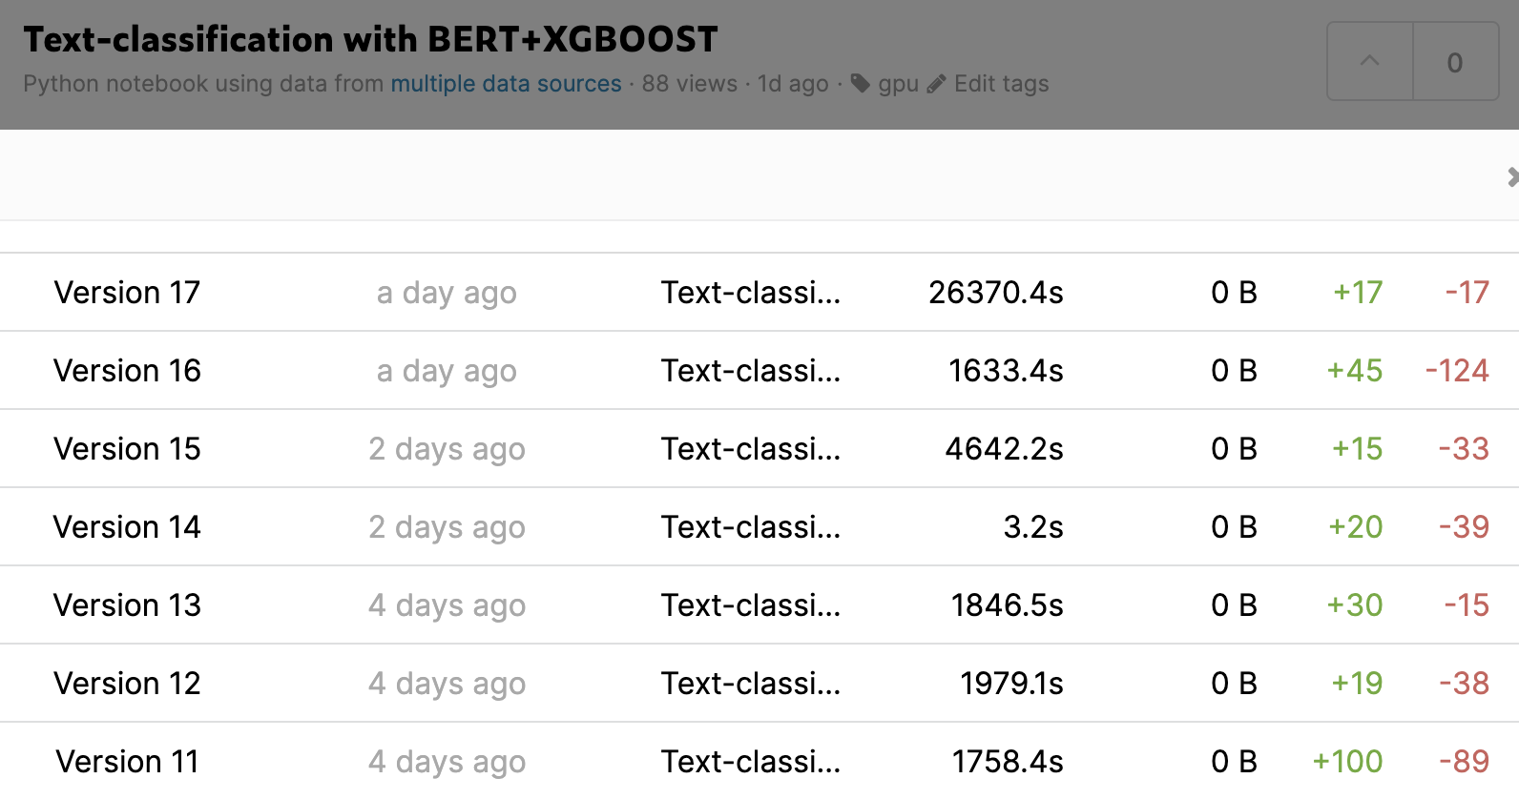
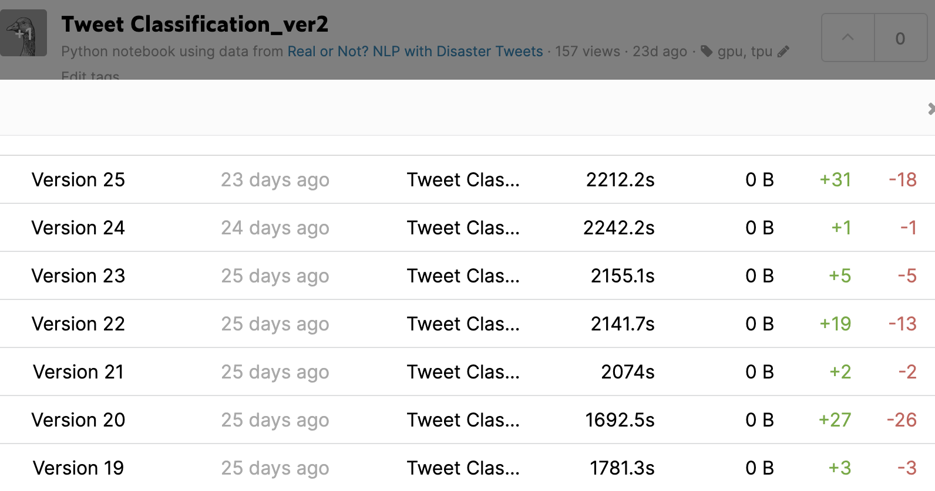
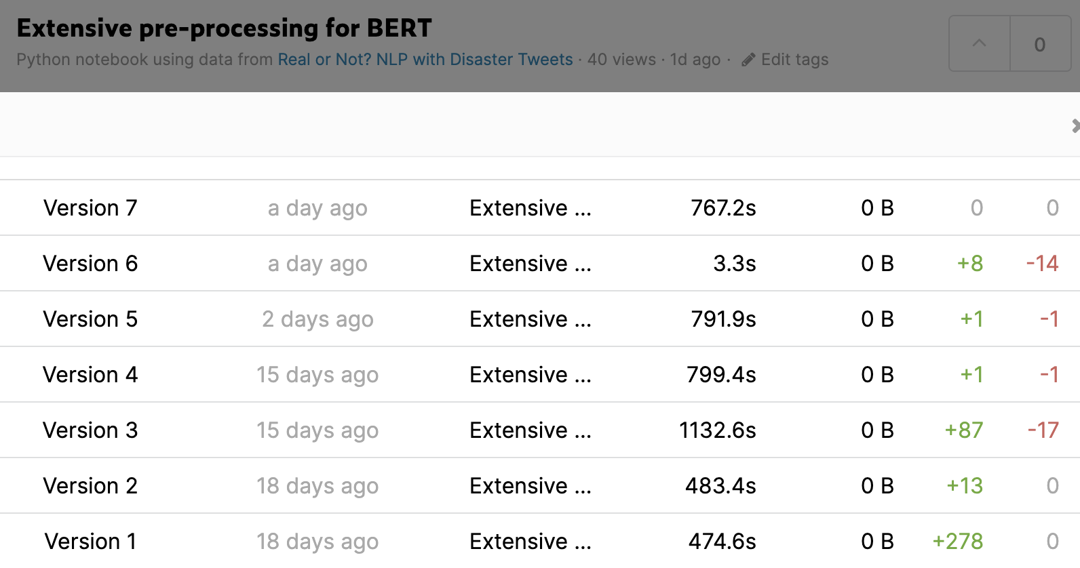
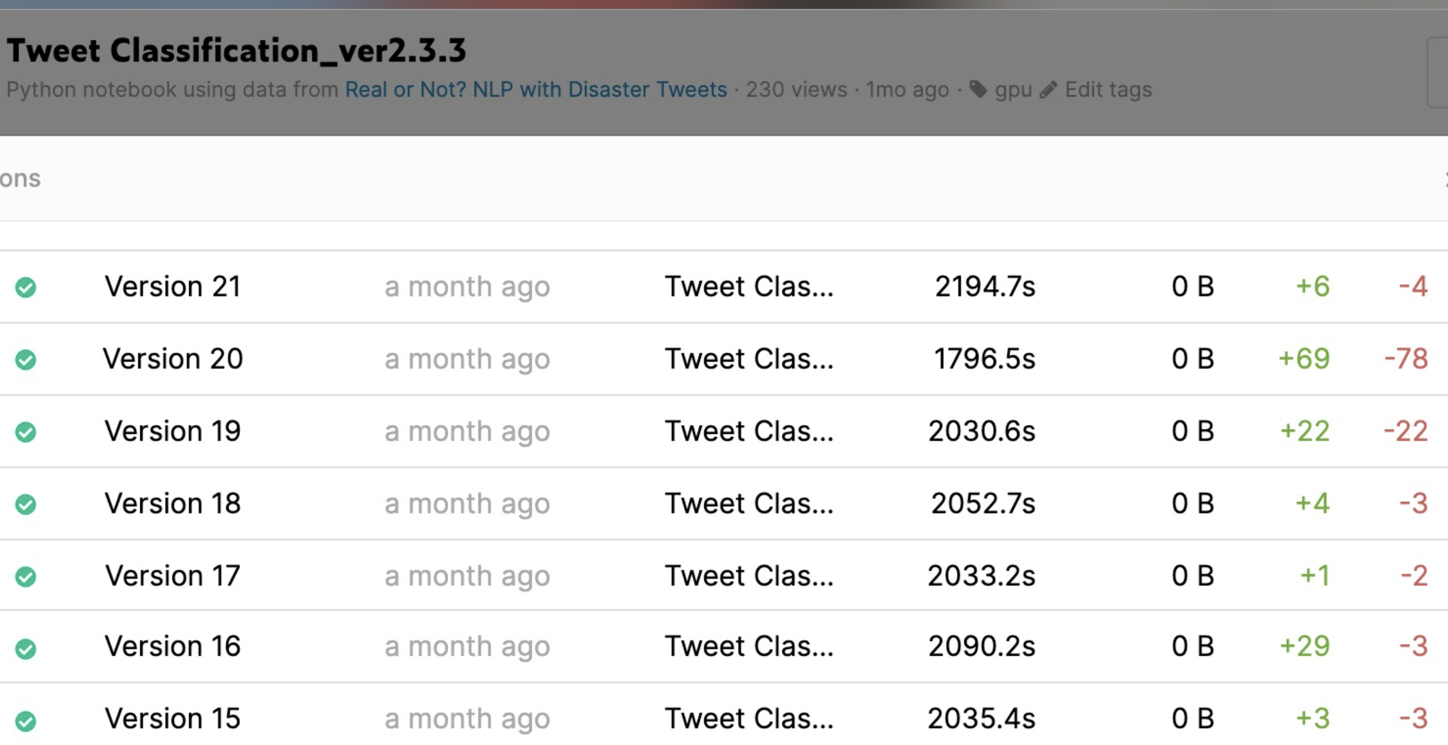

Version History

Slide 23

Trello Dashboard
https://trello.com/b/jMH5pISR/nlp-for-disaster-tweets

Slide 24
Challenges, Conclusions and Future Work
85% score on Test set sounds like a huge local minima in the loss curve, even on leaderboard a lot of people are struck there.
BERT indeed gives state of the art results.
Preprocessing is crucial in NLP.
Remotely working actually works.
Dig into the architecture of BERT for better Fine-tuning
Use ALBERT instead of BERT

Slide 25

Thank you
Questions?

